Slide 1
2019 NYC Airbnb Data
By: Matt Kennedy, Natalie Myers, Sedra Kurdi, Myles Bridges

Slide 2
Proposal
The purpose of this project was to analyze current calendar year data for Airbnb rentals in New York City (NYC), based on a dataset obtained from Kaggle.
The Pandas, Numpy, and Matplotlib modules in Python were used to clean and process the data, as well as calculate certain metrics and generate meaningful plots. These visualizations allowed for certain observations and conclusions to be made about Airbnb properties in NYC.
Also discussed are thoughts regarding target audiences for this data, possibly including Airbnb corporate, current property hosts, prospective property hosts, prospective guests and competitors offering guest accommodations.

Slide 3
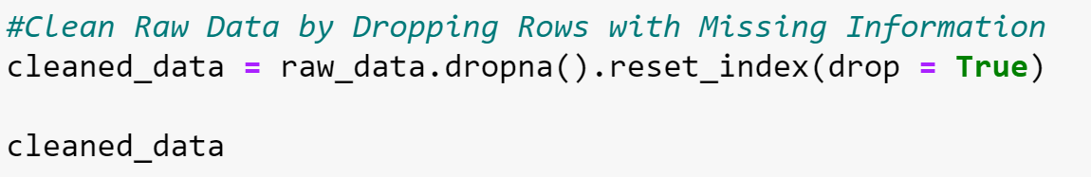
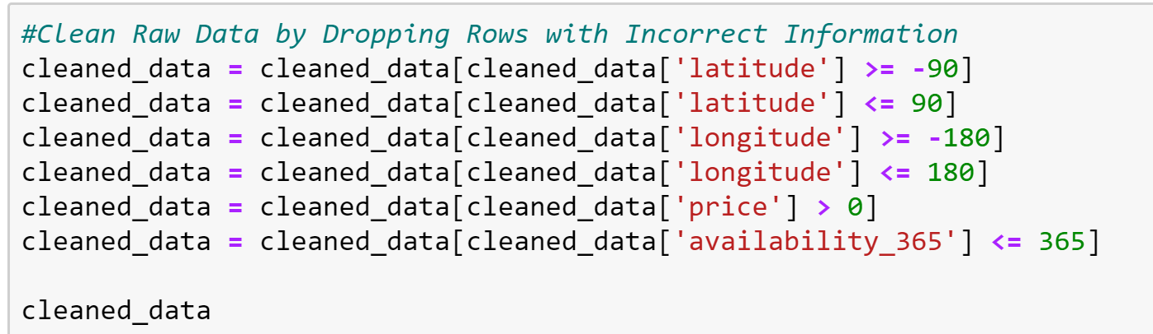
Cleaning Data

Slide 4
Questions For Our Entire Data Set
How many properties of each type are listed?
How many unique hosts are present for each type of property?

Slide 5
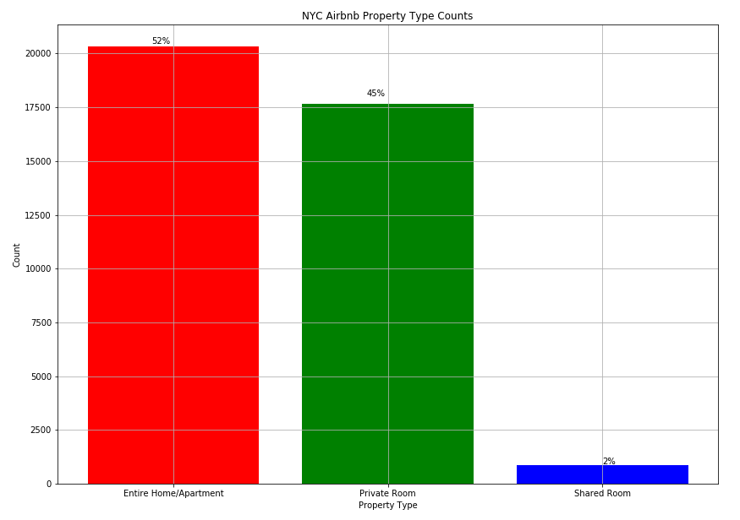
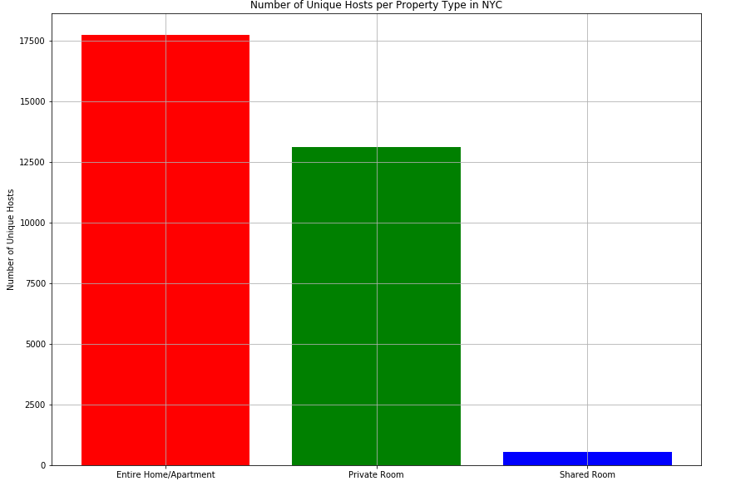
There are less hosts than properties. For example, there are 2,600 more listings for AirBnbs that are entirely private than there are hosts who list these types of spaces. Across all three types of properties, we find that hosts have multiple listings in NYC.
How many properties of each type are listed?
Total listings: 39, 000 listings in New York
52% of those are listings for having the entire place to yourself.
45% of the listings are for a private room in a shared space.
Only 2% of the listings are for a shared room.
How many unique hosts are present for each type of property?

Slide 6
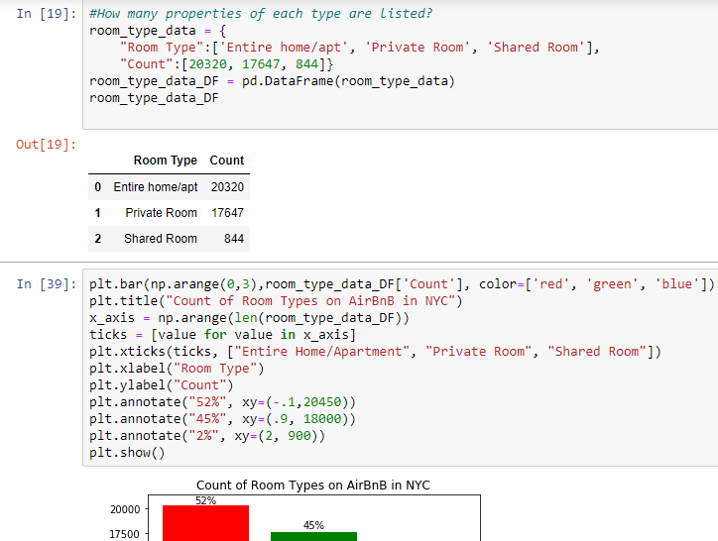
Code

Slide 7
Questions for Each Borough
How many properties of each type are listed within each borough?
What is the percentage of property types available within each borough?
What is the average number of days available for each type of property in each borough?
What is the average price for each type of property in each borough?
What is the average number of minimum nights for each type of property in each borough?

Slide 8
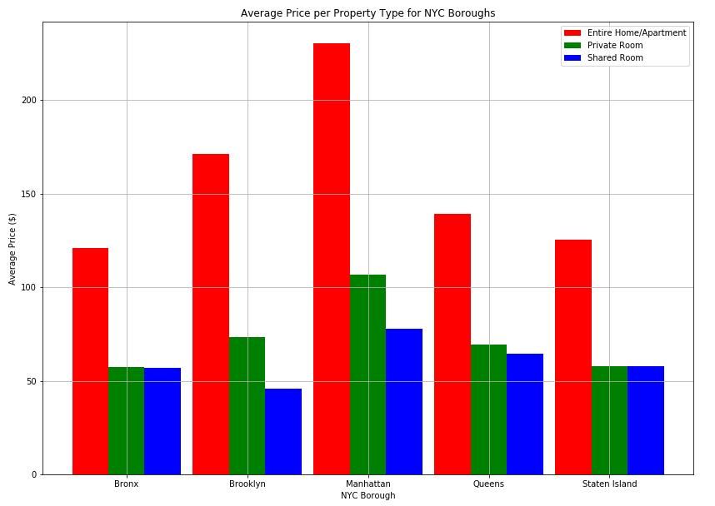
What is the average price for each type of property in each borough?
The price for an entirely private space is significantly higher than other types of properties.
In the Bronx, Queens, and Staten Island, the price difference between private rooms and shared rooms are slim.
The prices for all property types in Manhattan are the highest between all boroughs in NYC.

Slide 9
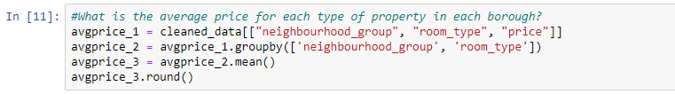
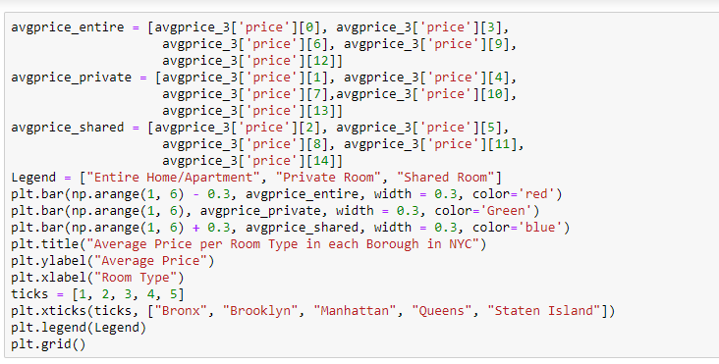
Code

Slide 10
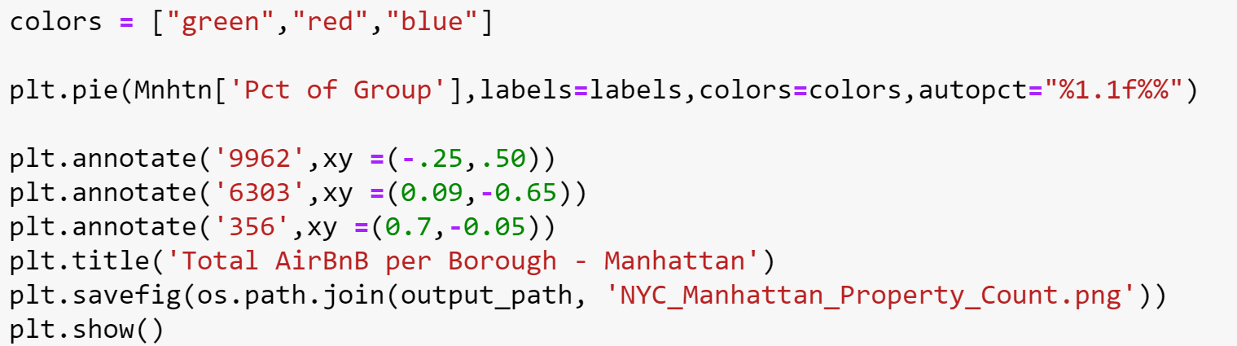
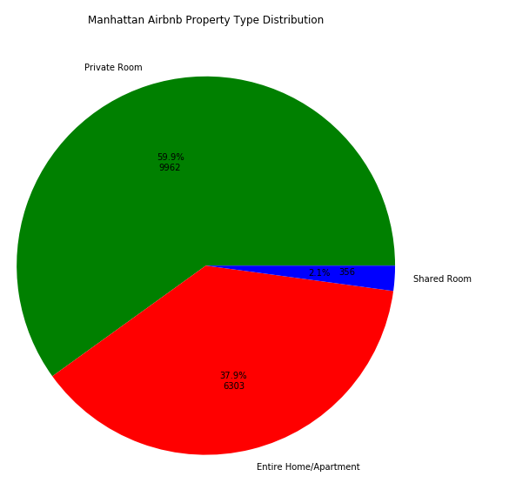
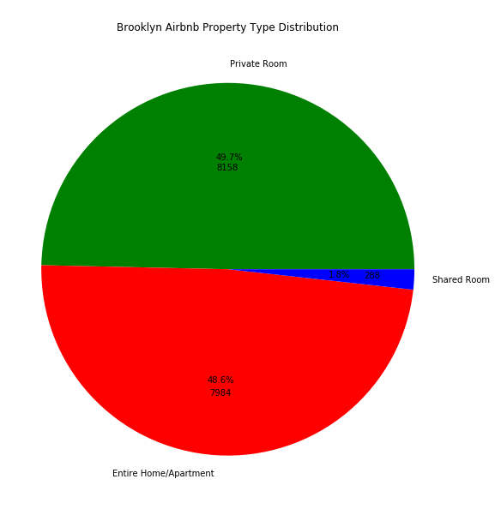
What is the percentage of property types available within each borough?

Slide 11
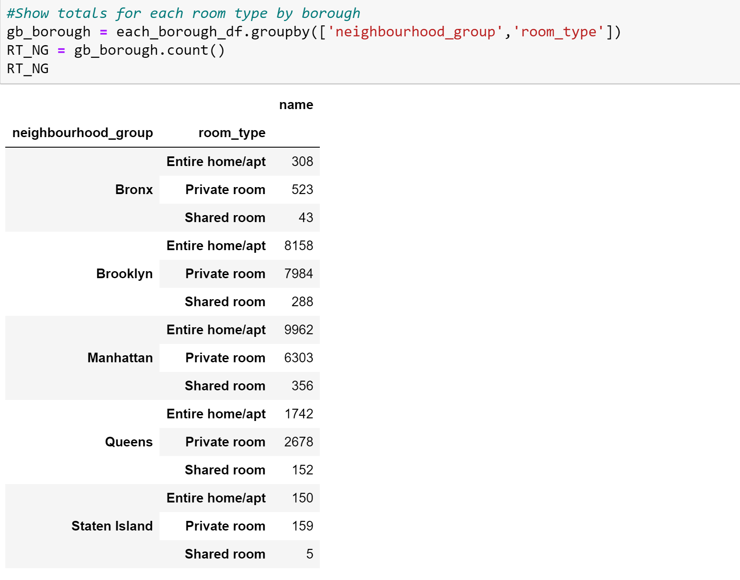
Code

Slide 12
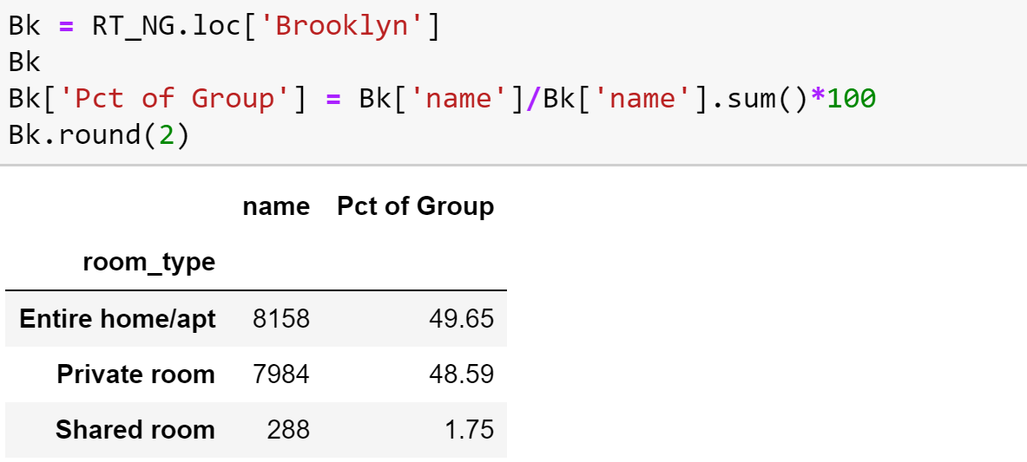
Separated Data Frame

Slide 13
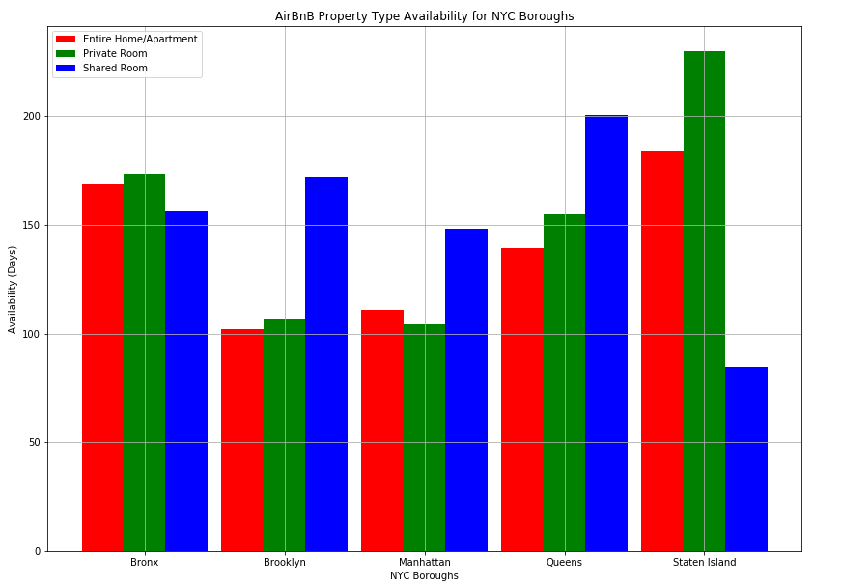
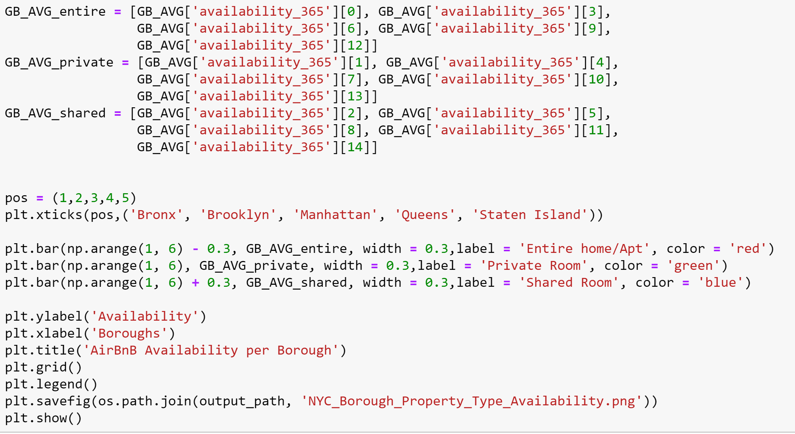
What is the average number of days available for each type of property in each borough?
AirBnB availability by Borough
7:22 PM
What is the average number of days available for each type of property in each borough?

Slide 14
Neighborhood Level Questions
In each borough, what are the 5 neighborhoods with the most reviews?
In each borough, what are the 5 neighborhoods with the highest percentage each property type?
In each borough, what are the 5 neighborhoods with the highest average price for each property type?
In each borough, what are the 5 neighborhoods with the lowest average price for each property type?
In each borough, what are the 5 neighborhoods with the lowest average number of minimum nights?

Slide 15
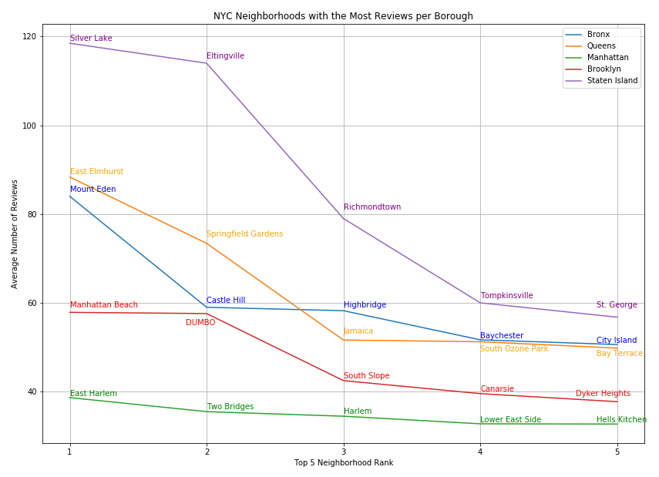
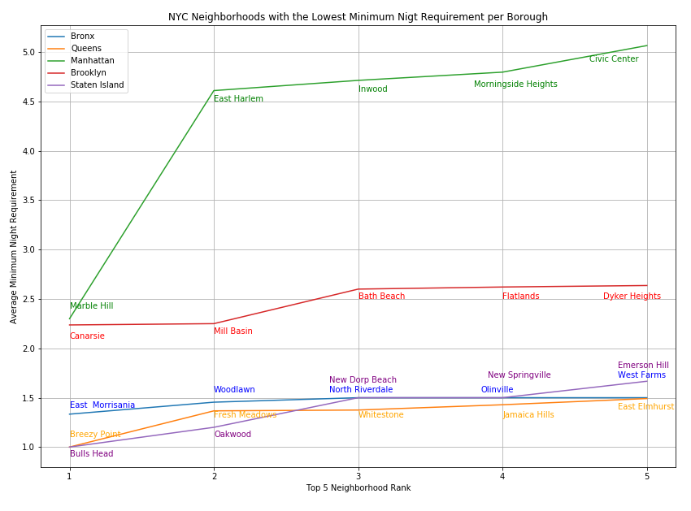
In each borough, what are the 5 neighborhoods with the most reviews?
In each borough, what are the 5 neighborhoods with the lowest average number of minimum nights?
Notes:
Chart 1 (Neighborhoods with the most reviews per borough)
This graph is interesting because it shows us that the number of reviews does not correlate to the success/popularity of a specific Airbnb location.
Staten Island has the least amount of both airbnbs and bookings, and yet the highest number of reviews out of all the boroughs.
Meanwhile Brooklyn and Manhattan, which are the most sought after boroughs for airbnbs, have the least amount of reviews.
We have gathered that this may be a result of more business people staying in Brooklyn and Manhattan vs. Staten Island and Queens. And from that inferring that people travelling for business are less likely to leave reviews of an Airbnb than tourists. Also we must consider the nature of the reviews. Our data does not cover if these reviews were positive or negative. We might assume that it is more likely that an Airbnb user would leave a negative review after a negative experience than a positive review after a positive experience.
Chart 2:
Lowest average number of minimum nights required to book the Airbnb means that the host may require a minimum of 2 nights in order to book the room, or a minimum of 5 nights. As you can see Manhattan requires the most nights to book the 5 lowest Airbnb neighborhoods. This matches what we might have expected, as airbnbs are most in demand in Manhattan, then Brooklyn, with the last three boroughs having very similar results. Where the demand is higher the host can better choose exactly when they would like to rent their property, and for how long – therefore maximizing the amount of rent-time per month.

Slide 16
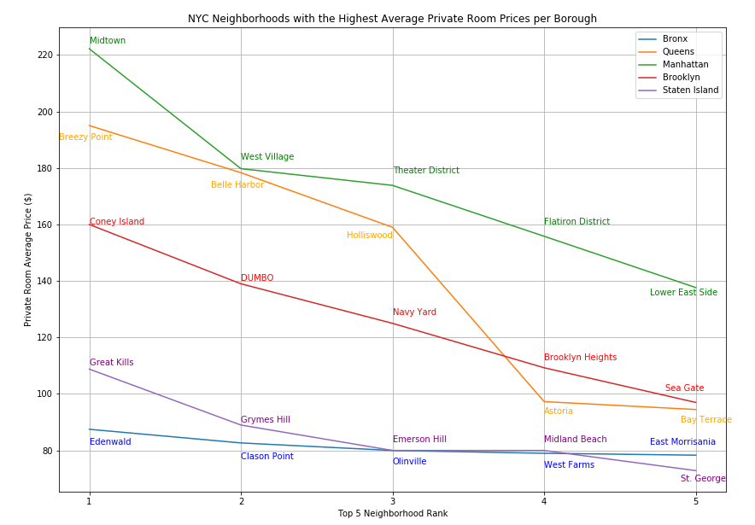
In each borough, what are the five neighborhoods with the highest and lowest average prices for each property type?
(This chart is for the highest priced private rooms)
Notes:
As would be expected Manhattan leads the boroughs for the top 5 neighborhoods with the highest priced private rooms. But, Queens comes up second for pricing, surprising as Brooklyn has higher demand for airbnbs. It can be gathered that Queens has a more appealing selection of private room properties than Brooklyn, and can therefore charge more for these rooms. Brooklyn may be a borough that is higher demand for the price conscious traveler.

Slide 17
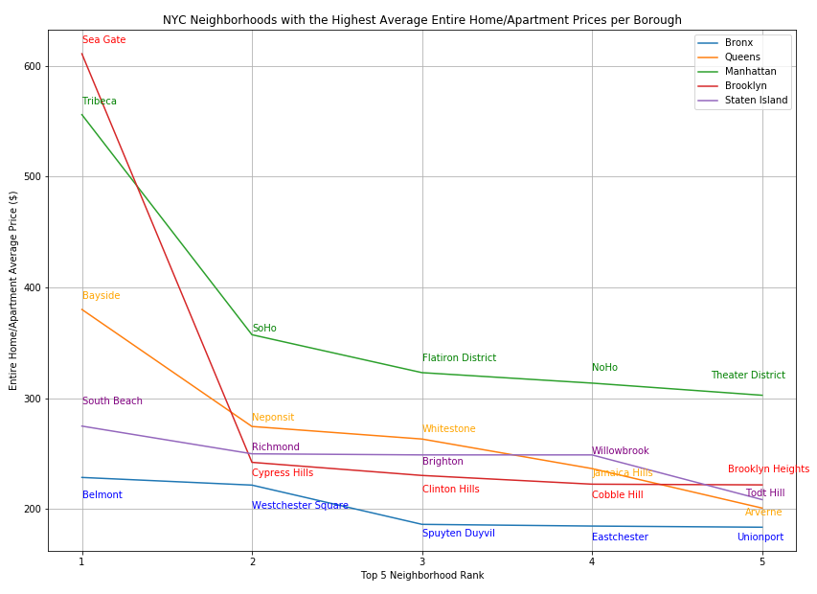
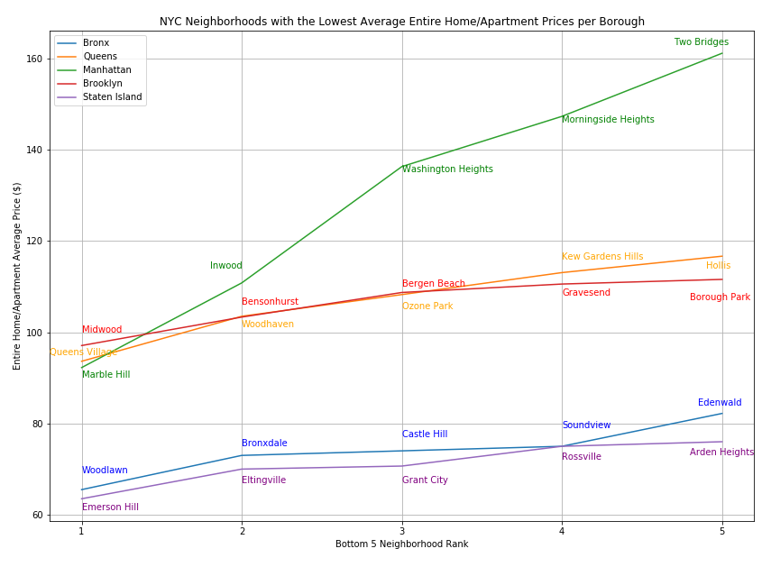
In each borough, what are the five neighborhoods with the highest and lowest average prices for each property type?
Highest Priced
Lowest Priced
Notes:
Chart 1
This graph is interesting as it displays that out of all the neighborhoods in all the boroughs, a Brooklyn Borough comes out on top for the Highest priced entire home/apt property.
Looking into this result a bit more, we see that Sea Gate is a luxury neighborhood off the water, and would appeal to a more wealthy clientele.
After that result, the rest of the data is what we would expect from the highest priced entire home/apt category.
Chart 2
Slightly interesting that the Bronx and staten island switched placed for these two graphs, showing that the Bronx does not have a very large range in pricing for its entire home/apt category, while staten island has quite a large price range for it’s relatively small selection of airbnbs. This may indicate that the Bronx has a selection of relatively less desirable properties, while Staten island offers some luxury properties, but cannot increase its pricing due to an undesirable location.

Slide 18
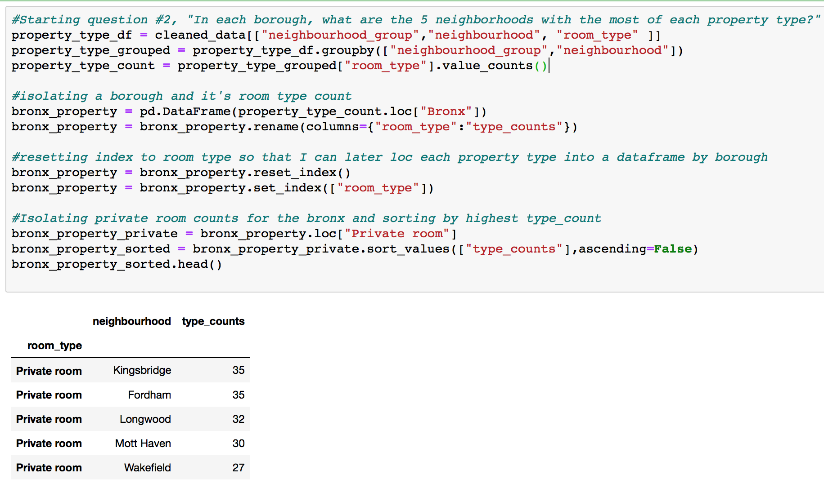
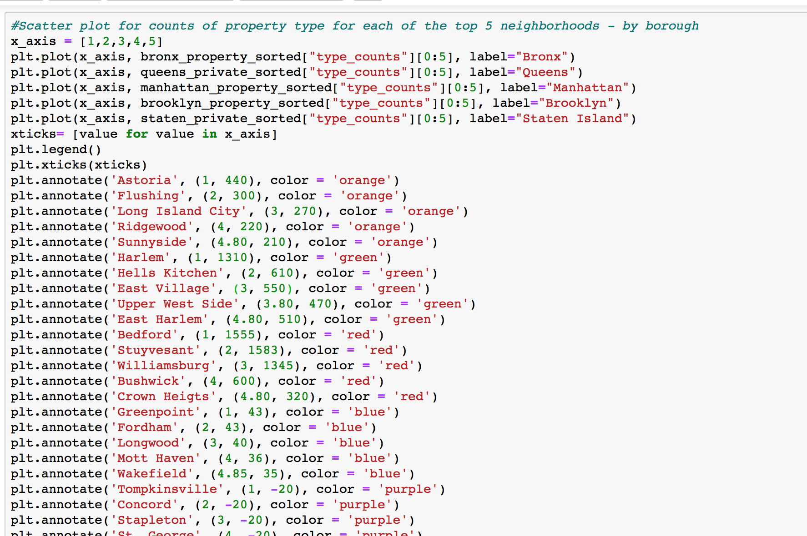

Slide 19
Target Audiences for Airbnb Data
Airbnb Corporate – Compare NYC Property Breakdown to Similar Cities (SFO/LAX) / Identify Need to Advertise for More Hosts
Potential NYC Airbnb Hosts – Set Appropriate Pricing & Minimum Night Requirements / Identify Whether to List Property in Specific Borough
Current NYC Airbnb Hosts – Adjust Listing Details (Pricing / Availability / Minimum Night Requirement)
NYC Airbnb Guests – Identify Most & Least Attractive Neighborhoods
Airbnb Competitors – Identify Most Competitive Areas

Slide 20
Ideas for Further Analysis
Property Latitude & Longitude - Identify Property Type Clusters within Boroughs & Neighborhoods
Property Latitude & Longitude – Evaluate Relationship Between Property Price / Availability / Minimum Night Requirement & Distance from NYC Mass Transit Links
Property Latitude & Longitude – Evaluate Relationship Between Property Price / Availability / Minimum Night Requirement & Distance from NYC Landmarks
Property Reviews – Evaluate Relationship Between Property Price / Availability / Minimum Night Requirement & Review Type (Need Data to Include Specific Nature of Reviews)

